Slide 1


RealTime/FieldBased Project Presentation On PICTOON-using OpenCV
R.LAWRENCE- 22R21A66B2
Under the Guidance of
Mrs.N.JAYA SREE
Assistant Professsor
Department of Computer Science & Engineering-Artificial Intelligence and Machine Learning
06/07/2024

Slide 2

Contents
Abstract
Introduction
Literature Survey
Existing System
Proposed System
Objectives
Architecture
UML Diagrams
References

Slide 3
ABSTRACT
Cartoonization is itself a classic art but, the advancement in the field of Machine Learning is covering almost every domain.
Cartoon-style pictures can be seen almost everywhere in our daily life. Image processing plays a significant role in all computer-related applications, mainly while processing and experimenting on images using image processing libraries.
Cartooning images seeks to leverage the existing OpenCV library.This work presents an approach to cartoonize digital images into cartoon-like.
OpenCV can be used to process images and videos for various tasks such as object tracking, face detection, object detection, and more.

Slide 4
INTRODUCTION
Cartoon-style pictures can be seen almost everywhere in our daily life.
Technology is the mode by which users can store, fetch, communicate and utilize information. Image processing plays a significant role in all computer-related applications, mainly while processing and experimenting on images using image processing libraries.
With the recent success of Instagram, the popularity of simple and fun photo effects apps has been on the rise. There is an issue that is to be addressed in the utilization of the social media i.e., Security.We can’t trust some sites as they might steal our information like mainly images and may use them in a bad way that affect them.
The security issue is a serious issue as it may cause catastrophic results.

Slide 5
LITERATURE SURVEY
Deep Learning-Based Classification of the Polar Emotions of “Moe”-Style Cartoon Pictures
(https://ieeexplore.ieee.org/stamp/stamp.jsp?tp=&arnumber=9220754)
Bilateral Filtering Based Image Cartoon Stylization Design
(eh7wHXWfdTFMV9kNmzN7qywox0Ld1E8mzwt6E6ok.pdf (francis-press.com))
Animating Static Pictures: A Cartoon Transformation Approach with OpenCV and Python
(https://jrctd.in/index.php/IJRCTD/article/view/15)
An Intelligent approach to Pic to Cartoon Conversion using White-box-cartoonization
IRJET_V9I5279-libre.pdf (d1wqtxts1xzle7.cloudfront.net)

Slide 6





EXISTING SYSTEMS
MOBILE APPS
ToonMe
Prisma
SnapChat
4. Adobe express
5. Painnt - are some mobile apps.
WEBSITES
Cartoonify
PhotoCartoon
Befunky
Fotor

Slide 7
PROPOSED SYSTEM
1. User-Friendly Interface: The application offers a clear and interactive user interface using Streamlit.
2. Image Manipulation Features: Users can resize images to specific dimensions and apply a variety of filters to enhance their images, all through simple sidebar options.
3. Dataset Integration: Predefined categories of images(such as Pets, Flowers, Actors, etc., )are available for selection .
4. Downloadable Results: After applying the desired changes, users can download the processed image directly to their device, ensuring a smooth end-to-end experience.
5. Backend Image Processing: The application leverages robust backend functions for resizing and applying filters to images, ensuring high-quality output and efficient processing.

Slide 8
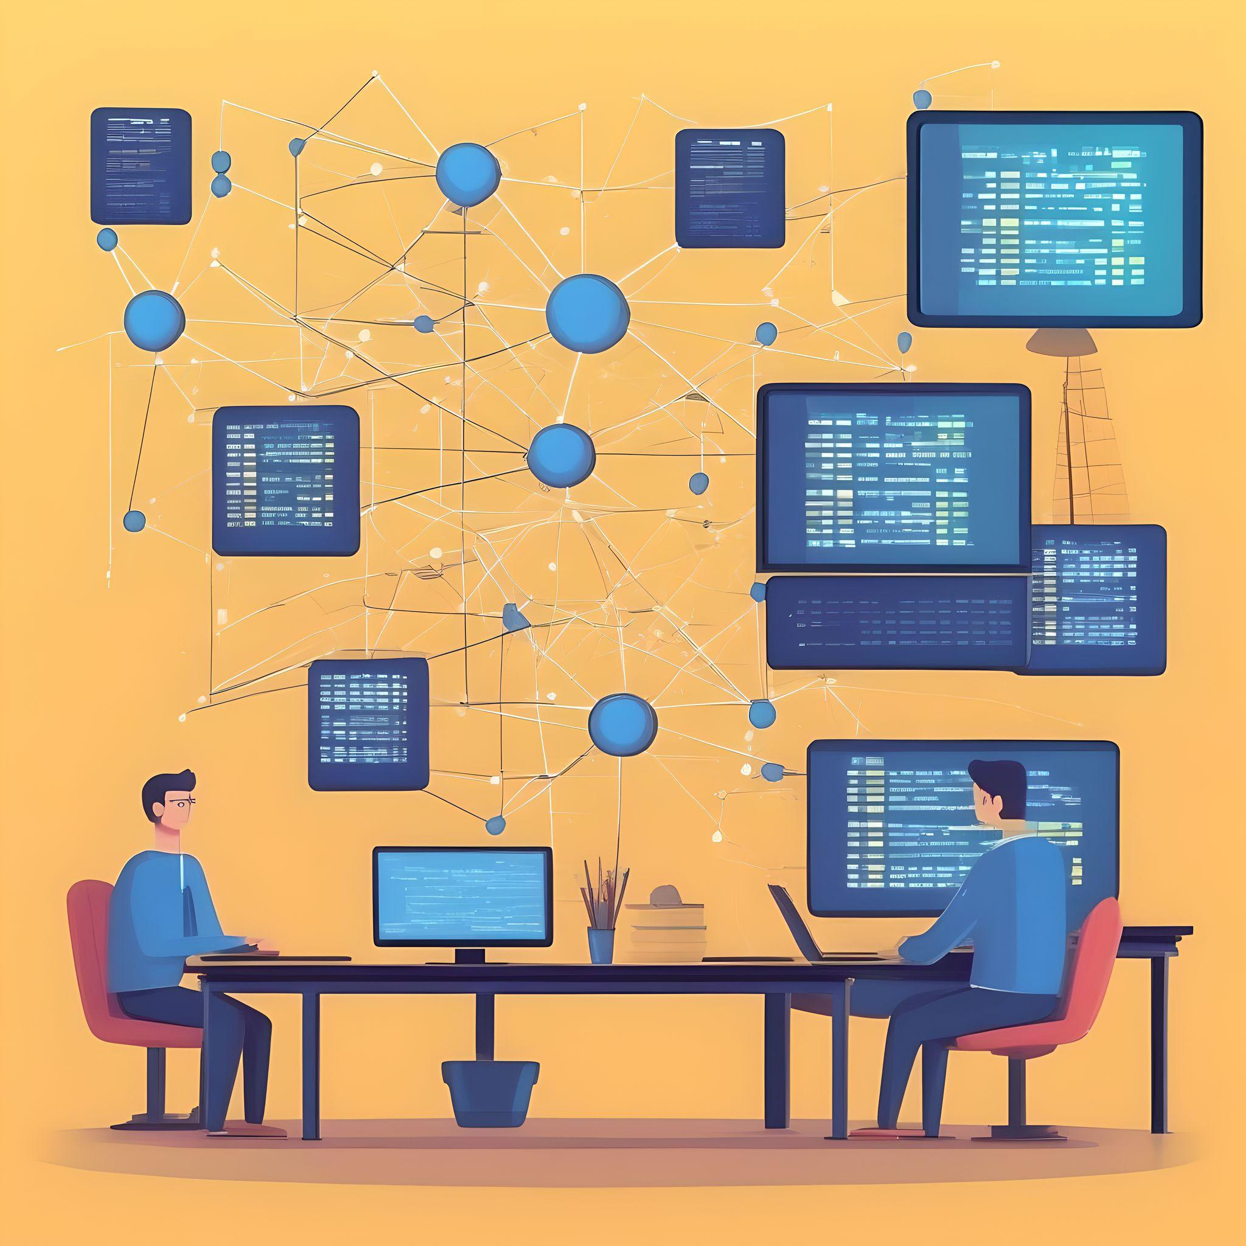

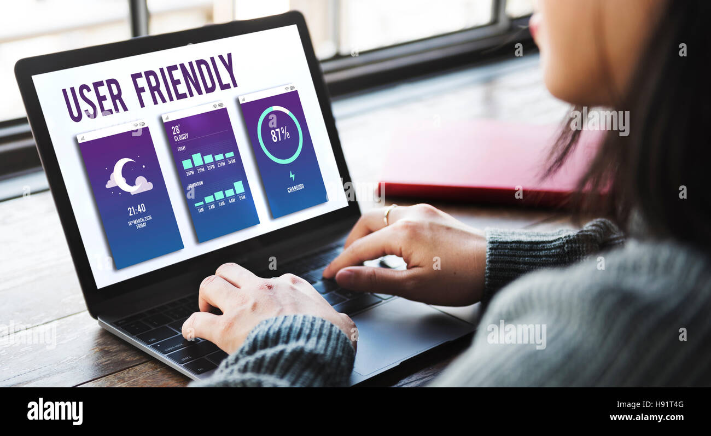
OBJECTIVES
1.
2.
3.

Slide 9
ALGORITHMS USED
Adaptive Thresholding:
Adaptive thresholding the threshold value for each pixel is determined individually based on a small region around it. Thus we get different thresholds for different regions of the image and so this method performs well on images with varying illumination. OpenCV provides us the adaptive threshold function to perform adaptive thresholding.
Laplacian Operator:
The Laplacian operator is a second-order derivative operator that is used in image processing to highlight regions of rapid intensity change, which often correspond to edges. In the context of image processing, the function represents the intensity of the pixels in an image.
Used in the cel_shading function for edge detection.
Canny Edge Detector:
The Canny edge detector is a multi-stage algorithm for detecting edges in images
Gradiant calculation,noise reduction.
Used in the comic_book, manga, and cartoon_3d functions to detect edges.

Slide 10
Cartoon :
Algorithm:
Converts the image to grayscale.
Applies a median blur to the grayscale image.
Uses adaptive thresholding to detect edges.
Applies a bilateral filter to the original image.
Combines the edges with the filtered image using a bitwise AND operation.
Pencil Sketch :
Algorithm:
Uses OpenCV’s built-in cv2.pencilSketch() function, which generates a pencil sketch-style image.
Cel Shading :
Algorithm:
Converts the image to grayscale.
Uses the Laplacian operator to detect edges.
Thresholds the edge-detected image to create a binary mask.
Applies a bilateral filter for color quantization.
Combines the quantized image with the edge mask using a bitwise AND operation.

Slide 11
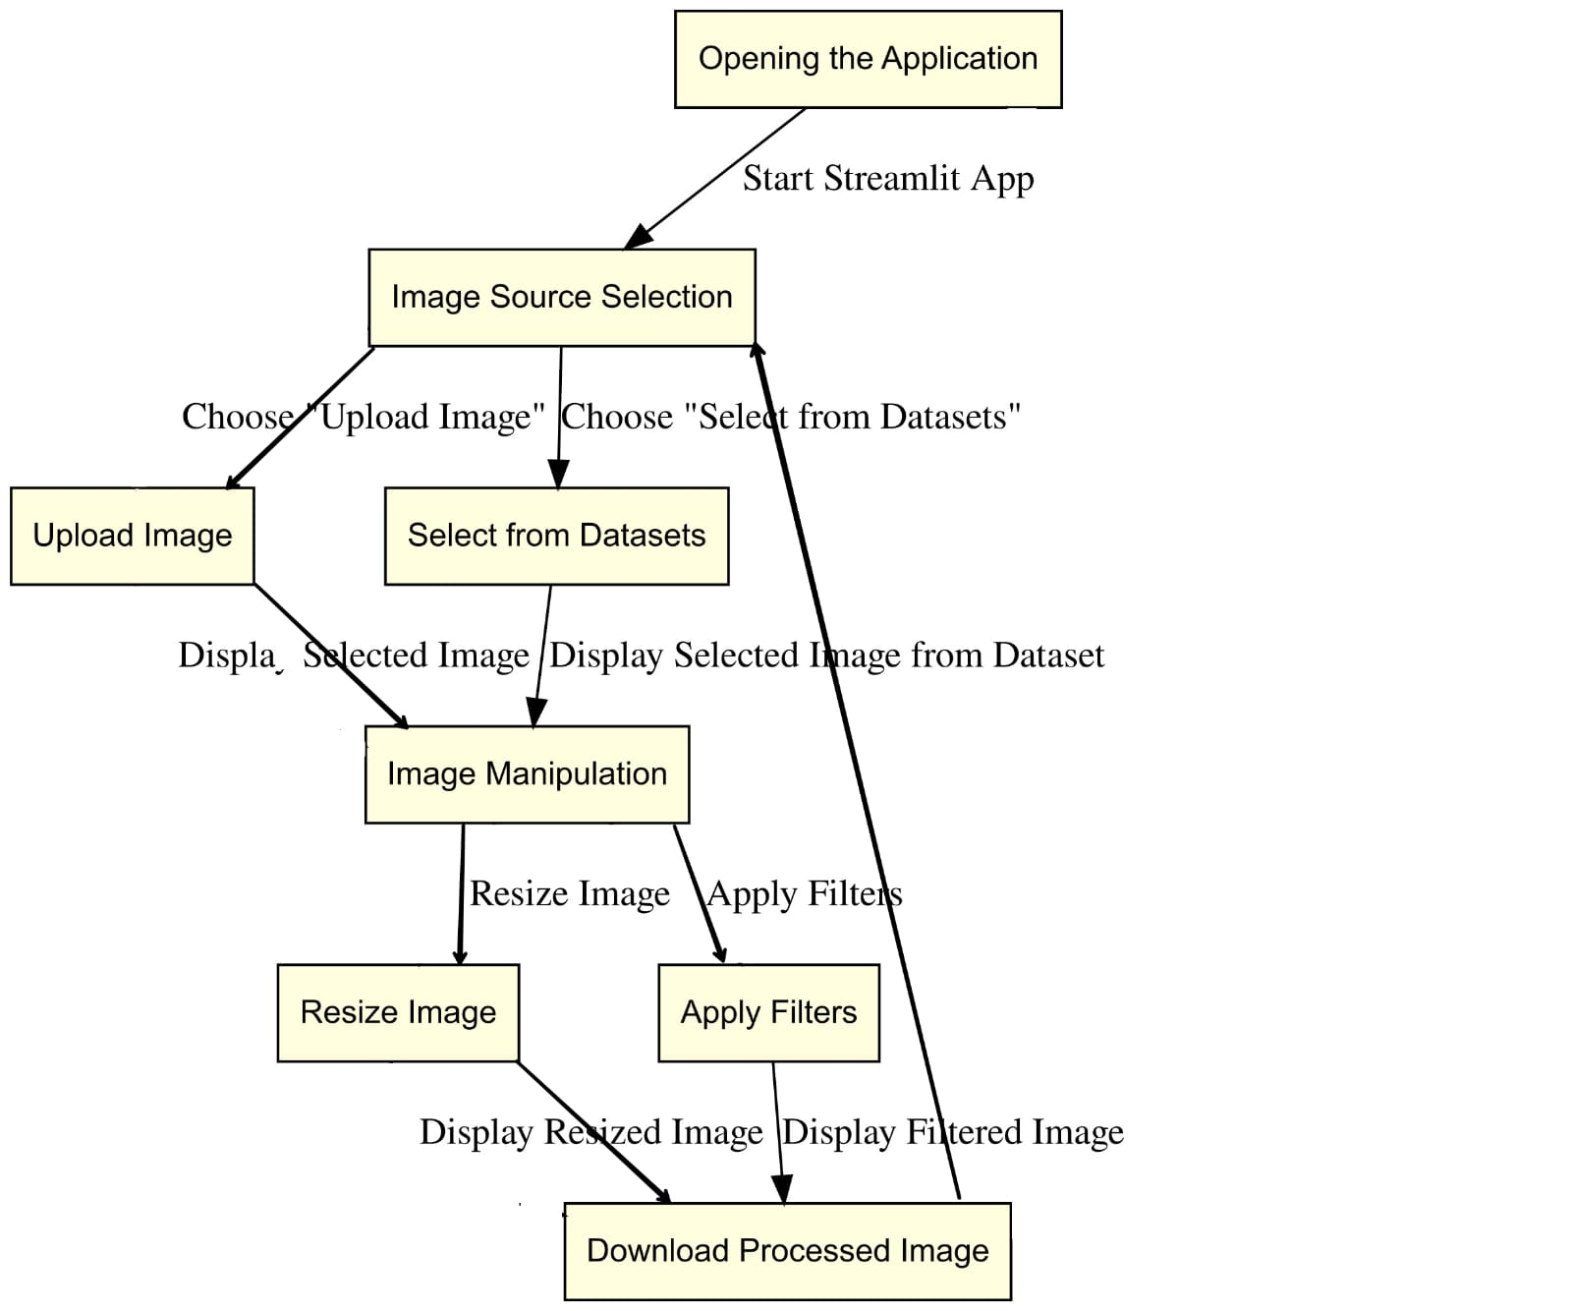
ARCHITECTURE
FIG: Architecture of PICTOON

Slide 12
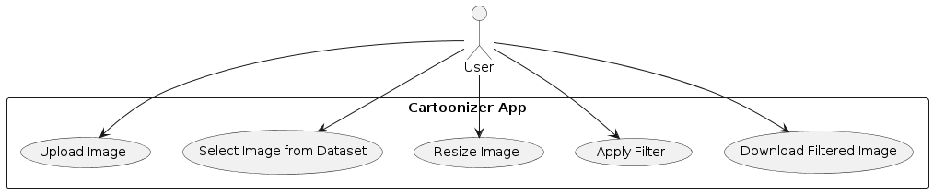
UML DIAGRAMS
Use Case Diagram

Slide 13
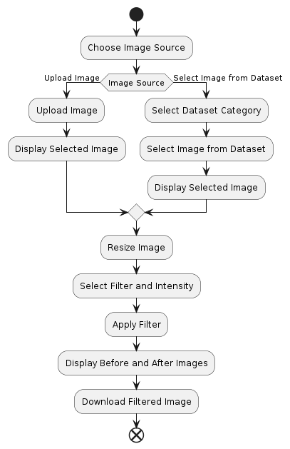
UML DIAGRAMS
Activity Diagram

Slide 14
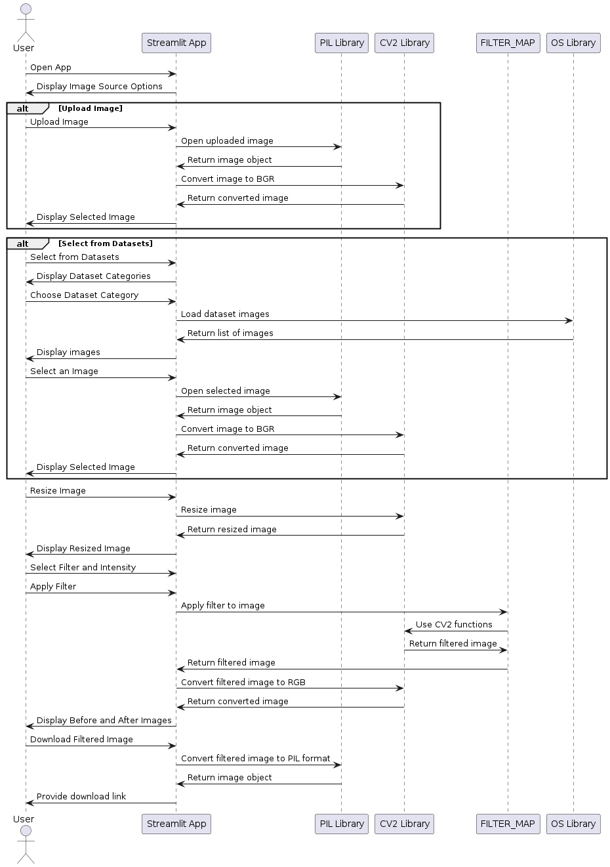
UML DIAGRAMS
Sequence Diagram

Slide 15
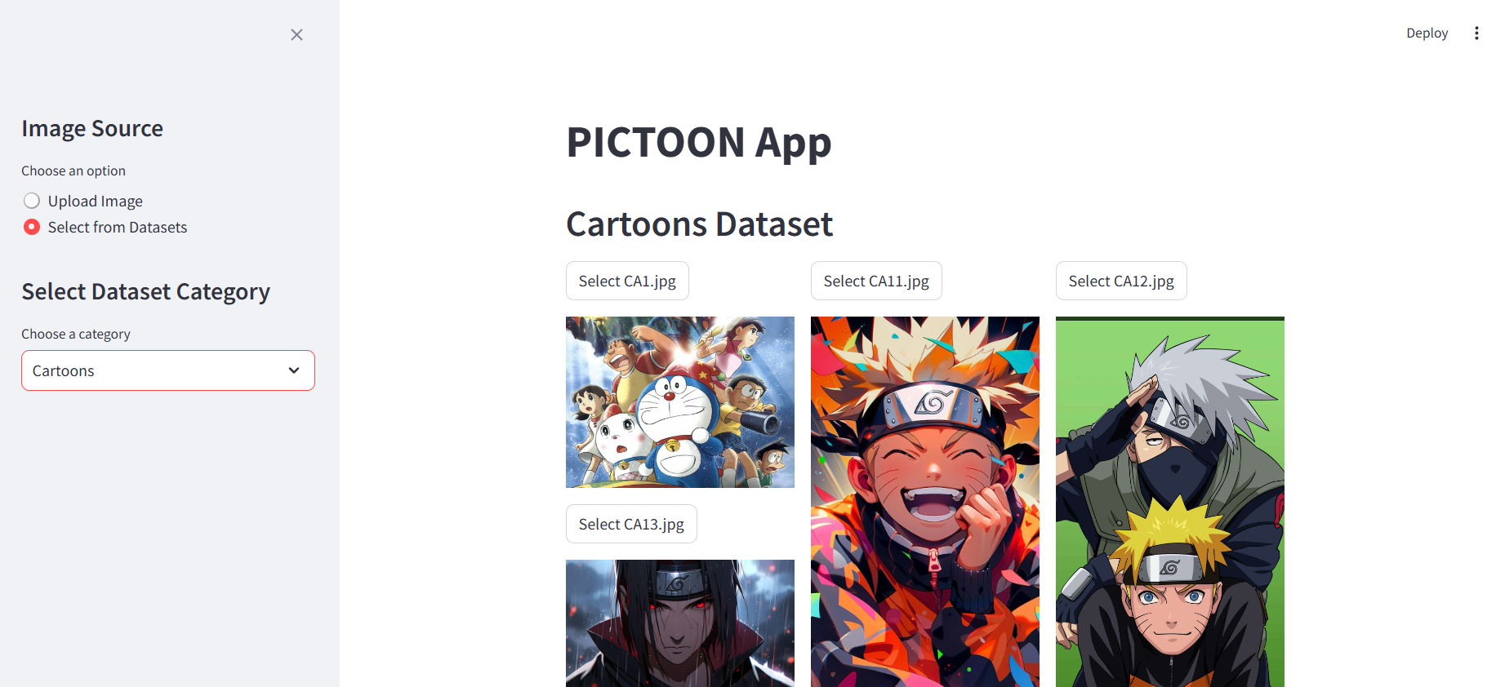
EXECUTION
INTERFACE

Slide 16
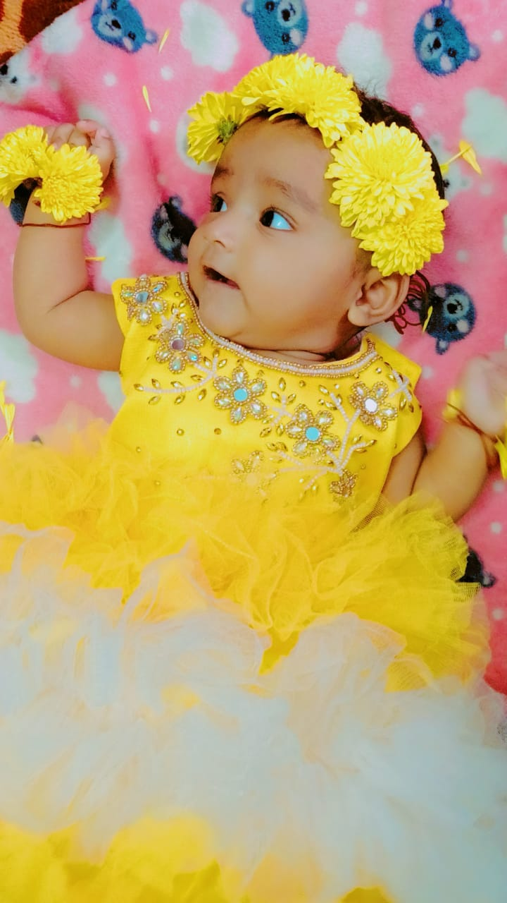
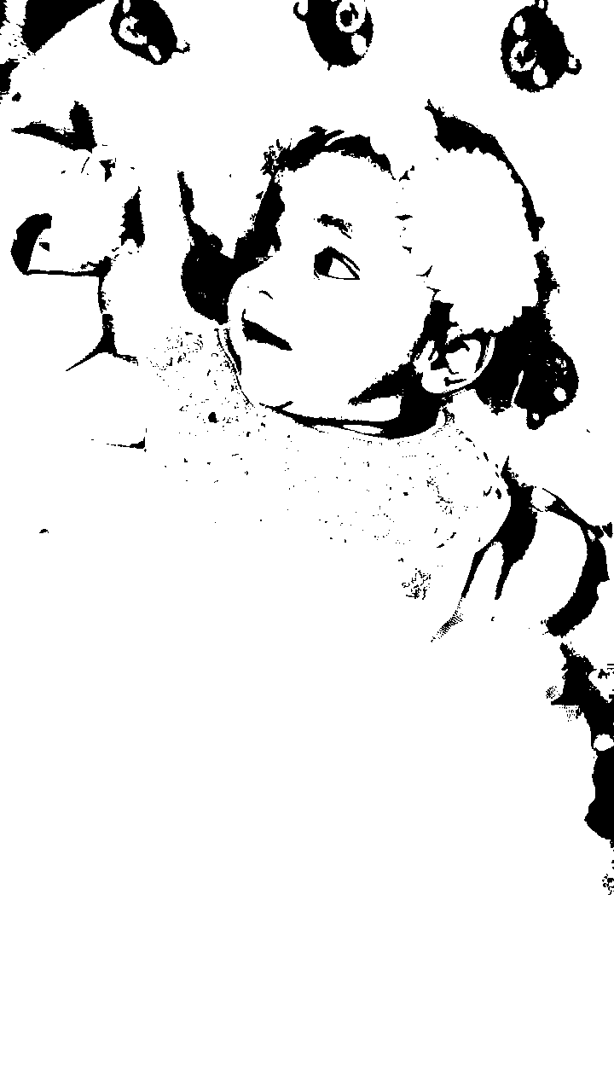
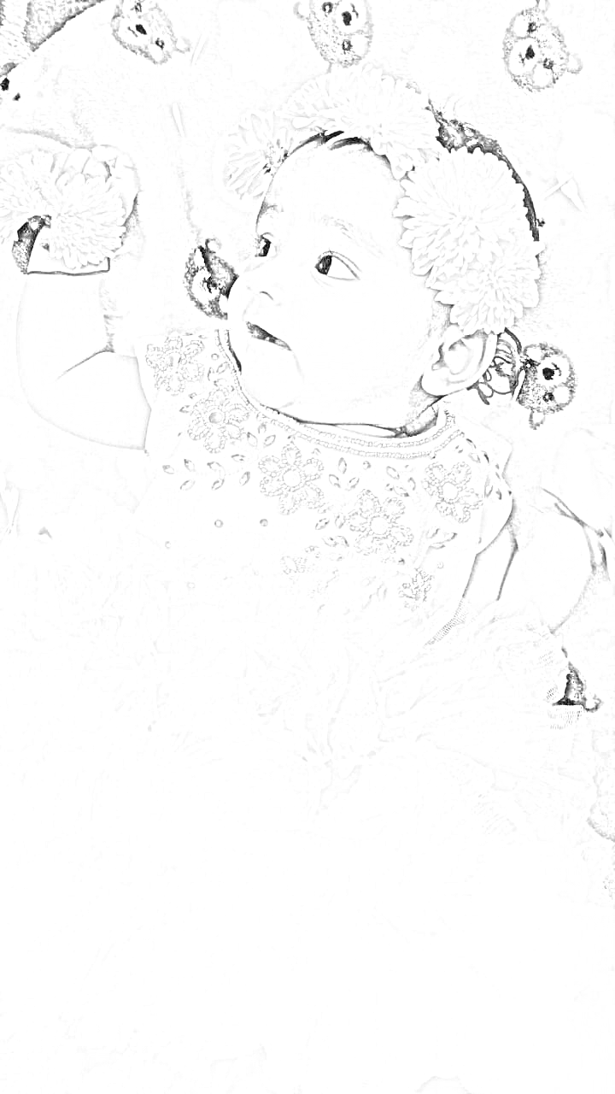
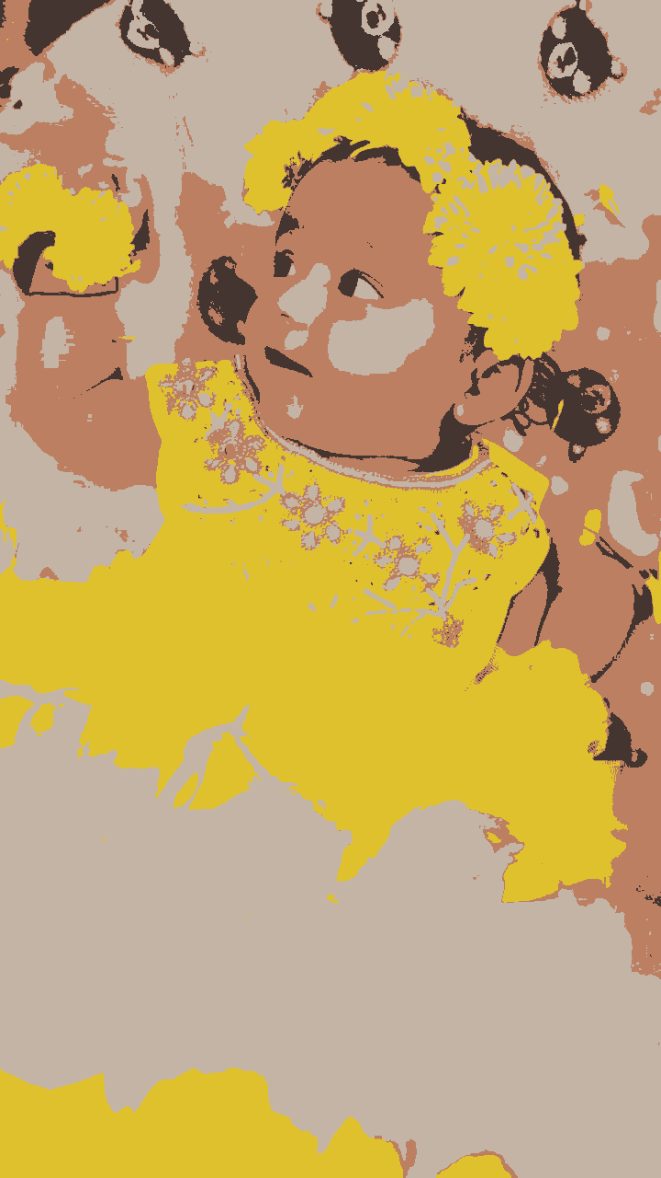
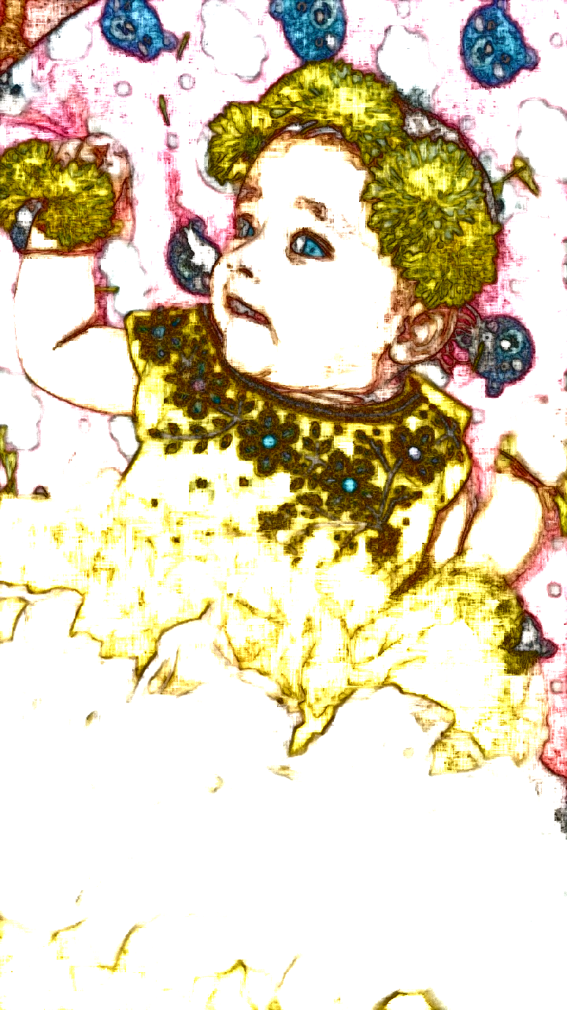
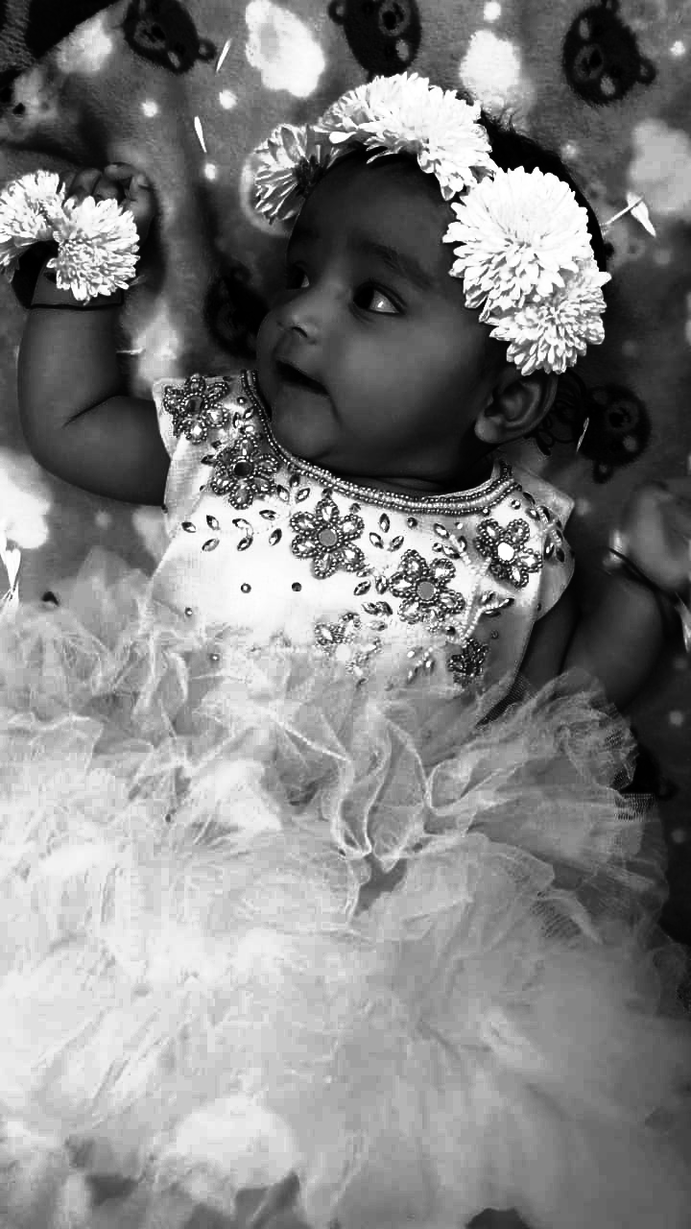
OUTPUT
INPUT IMAGE
FILTERED IMAGES

Slide 17
CONCLUSION
The PICTOON is a pioneering application designed to democratize the process of transforming ordinary photographs into captivating cartoon-like images. Leveraging advanced image processing techniques, the app provides a seamless user experience, allowing individuals to apply a variety of artistic filters to their photos. Users can either upload their personal images or choose from a comprehensive set of curated datasets, encompassing categories such as pets, flowers, actors, cartoons, cars, and buildings. This flexibility caters to diverse interests and ensures that the app can be used for a wide array of creative and practical applications.

Slide 18
FUTURE SCOPE
This project can further be developed into much efficient application by including many more features such as addition of more filters and many other features that reduces the effort of users such as we can add feature to restore the pixels and make the blur images much clear .
We can use AI to change background of the uploaded image as user wishes and further more.
Making our application compatible on every device.
We can also add video clips for filtering into different filters…

Slide 19
REFERENCES
Academic Papers
"A Computational Approach to Edge Detection" by John Canny.
"Bilateral Filtering for Gray and Color Images" by C. Tomasi and R. Manduchi.
Books
"Learning OpenCV:Computer Vision with the OpenCV Library"by Gary Bradski and Adrian Kaehler"
"Digital Image Processing" by Rafael C. Gonzalez and Richard E. Woods".
Software and Libraries
OpenCV, NumPy,PIL.

Slide 20


